Slide 1

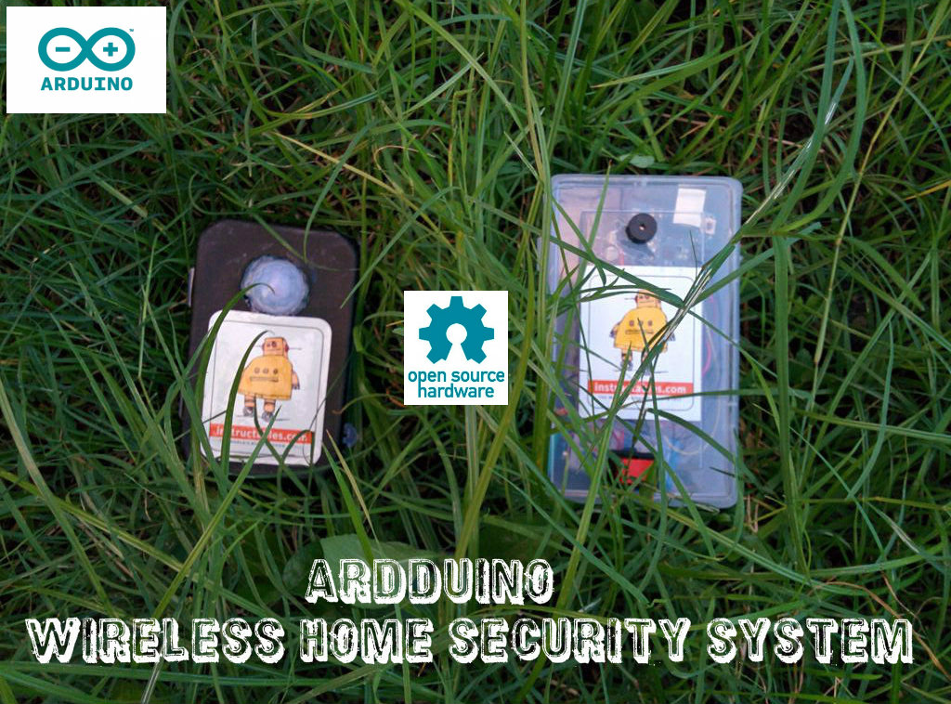
WIRELESS HOME SECURITY SYSTEM USING ARDUINO
NAME : Y.PRATHYUSHA
P.HARIKA
J.SAI CHANDAN
ROLL NO. :14311A0211
14311A0214
14311A0244
BRANCH: EEE
SECTION: A

Slide 2
CONTENTS:
Introduction
Components
Transmitter
Receiver
Circuit Diagram
Software
Bread Board Test
Transmitter and Receiver Module
Increasing the range
Power supply
Advantages
Disadvantages
Applications
References

Slide 3
INTRODUCTION:
Have you ever wanted to build a project that could detect the presence of a person in a room? If so, then we can do this very easily using the PIR (Passive Infra Red) Motion sensor. This Arduino motion sensor can detect the presence of a person in a room which then creates an alarm sound using a buzzer to scare the intruder away. Therefore, we can build projects such as burglar alarms, automated appliances, etc.
It uses a PIR motion sensor to detect the human motion and this information is transmitted without wire by using a RF transmitter-receiver module to give some sort of alert. RF module is preferred for wire less communication because compared to the existing wireless systems like blue tooth, XBee or WiFi ,it is user friendly and very cheap.
We can also use IR, but that has a limited range and can only work within a line of sight of the receiver. But using the RF module we can communicate within the range of around 100m.

Slide 4
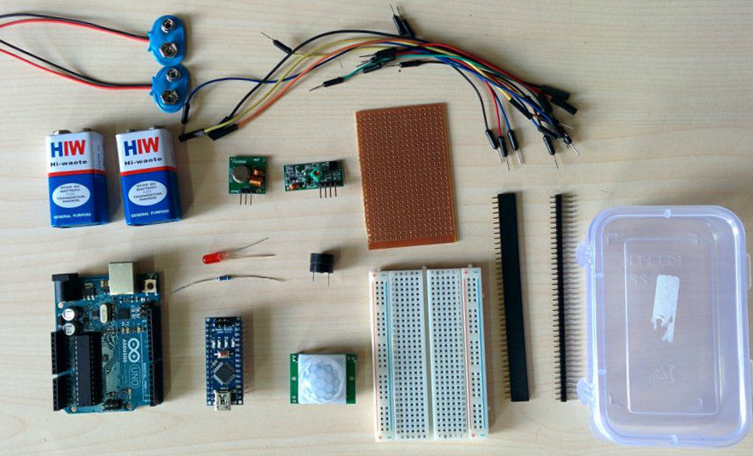
COMPONENTS:
ARDUINO UNO/ARDUINO MINI/ARDUINO NANO or similar board – 2
TRANSMITTER : To sense the human motion and transmit the data to receiver
RECEIVER : Receive the data from transmitter and activate alarm system and camera etc.
SOFTWARE : That operates the entire hardware used in this project.
PIR sensor
9V battery – 2
Buzzer
LED
Resistor -220 ohm
Bread Board
Jumper Wires
Perforated Board
Header connectors
Switches

Slide 5
TRANSMITTER:
The transmitter consists of
1. PIR sensor to detect the human motion
2.Arduino to process the data from PIR sensor
3. RF transmitter to transmit the data to the receiver
Passive infrared sensors work by measuring incoming infrared from human or animal. They do not emit energy themselves, which is why they are called "passive". Humans and animals both release infrared energy. Passive infrared sensors(sometimes called pyro electric detectors) detect this energy and give a signal to the ARDUINO.

Slide 6
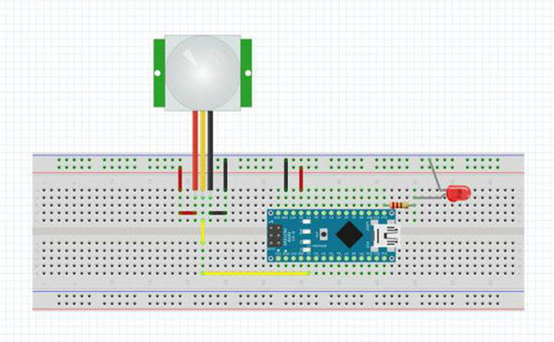
Connect the PIR sensor
PIR Pin Arduino Pin
VCC -----> 5v
GND .......> GND
Out ........> D2

Slide 7
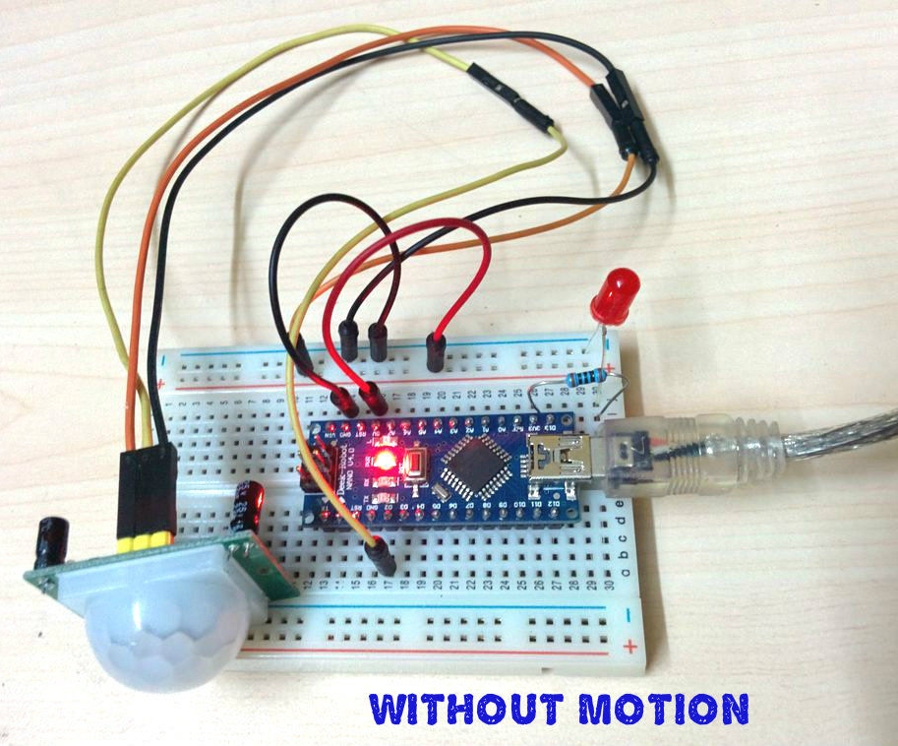
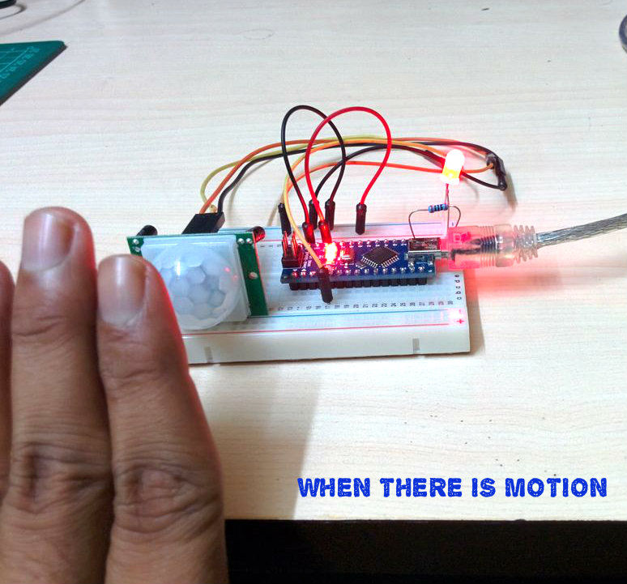

Slide 8
RF TRANSMITTER:
The RF transmitter has 3 pins( VCC, GND, and Data).
Connect the VCC pin to the 5V pin of the Arduino board that you are using (In my case it is Nano).
Connect the GND to the GND of the Arduino board.
Connect the data pin to the pin number 12 of the Arduino board.

Slide 9
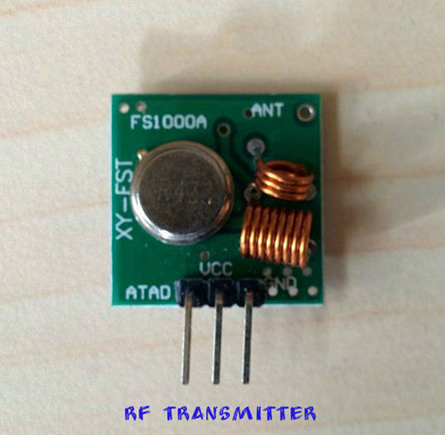
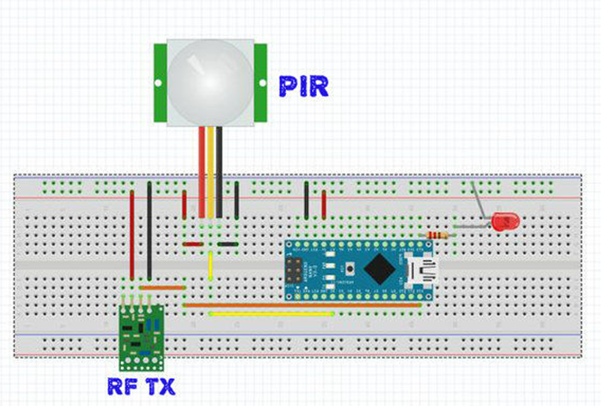

Slide 10
RECEIVER:
The Receiver consists of
1. RF Receiver module to receive data from transmitter
2. Arduino to process the data from RF Tx and give an out put (alarm,sms ,email etc)
3. Out Put : buzzer
Connect the VCC pin to the 5V pin of the Arduino board that you are using (In my case it is Uno).
Connect the GND to the GND of the Arduino board.
Connect the data pin to the pin number 12 of the Arduino board.

Slide 11
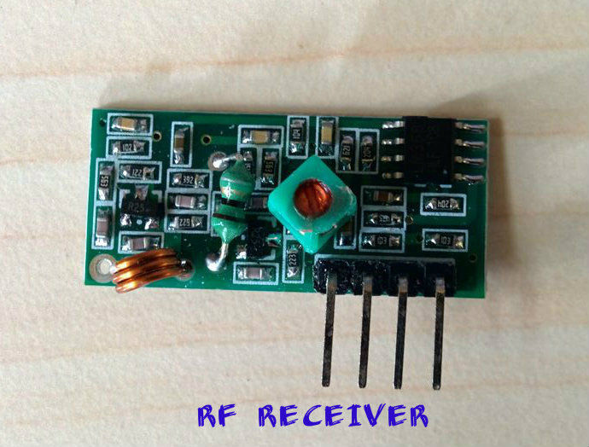
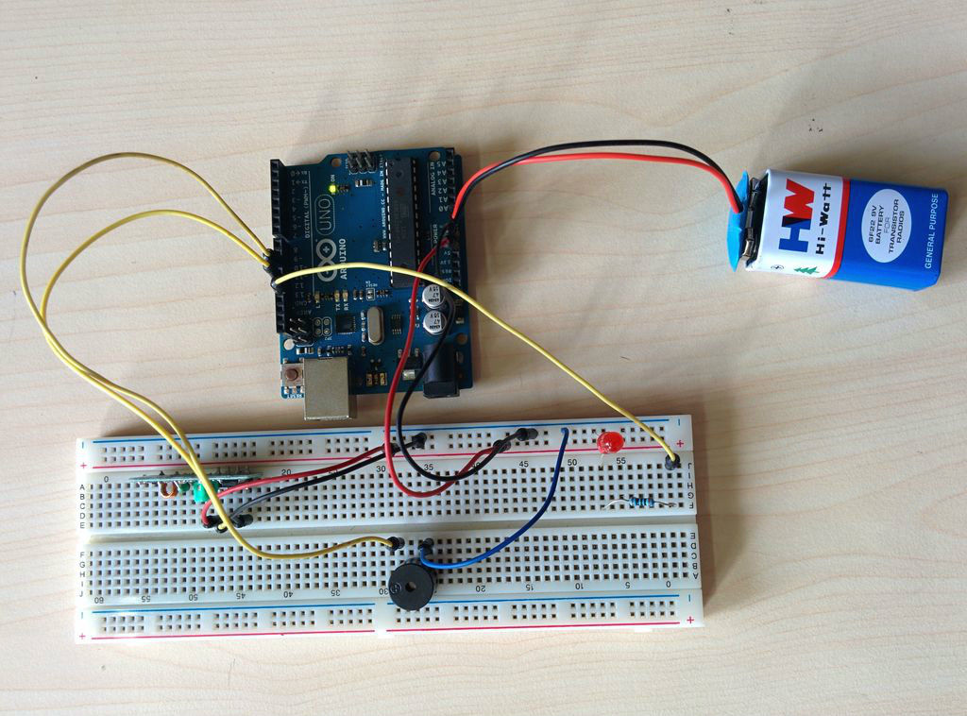

Slide 12
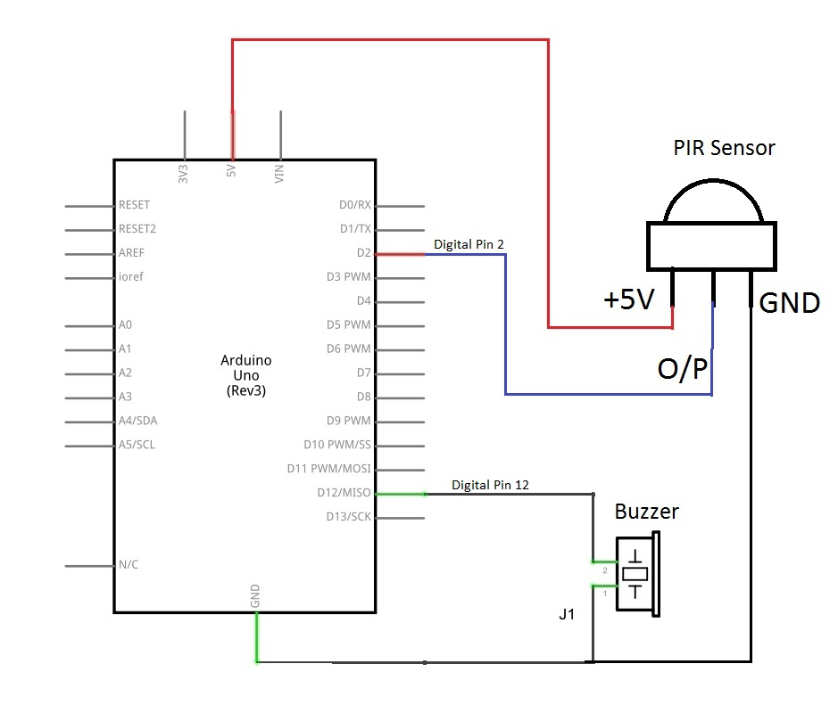
CIRCUIT DIAGRAM:

Slide 13
SOFTWARE:
Software for Transmitter:
1.Board -> Arduino Nano
2.Serial Port -> COM XX (check the com port in which your device is connected )
After setting the above things, write down the code wireless_tx and upload it.
Software for Receiver :
Similar to the above set the following for receiver board
1.Board -> Arduino UNO
2.Serial Port -> COM XX (check the com port in which your device is connected)
After setting the above things,down the code wireless_rx and upload it.

Slide 14
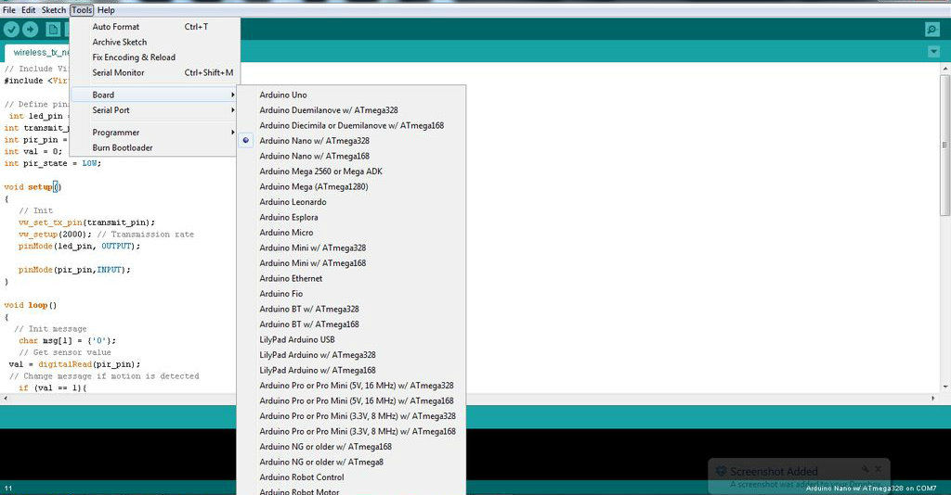

Slide 15
BREAD BOARD TEST:
After uploading the code to both transmitter and receiver board ,now it is time to check whether every thing works correctly or not.
Remove the Usb cable from both the board
Provide external power (battery ) to the both the board.( positive terminal goes to Vin )
Then shake your hand in front of the PIR sensor.
If the buzzer in the receiver board starts to make noise then every thing works fine.
Now it is time to make a portable device for practical use.

Slide 16
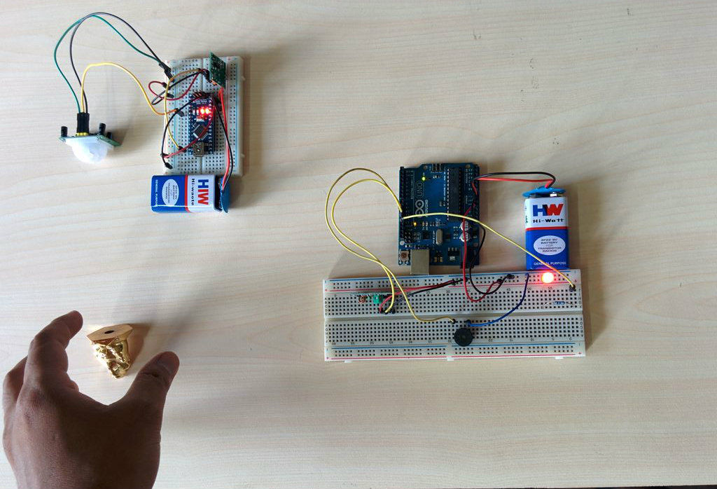

Slide 17
TRANSMITTER MODULE:
Cut header connectors for arduino nano (15 pins 2nos ),PIR sensor (3 pins),RF transmitter (3 pins) and Power (2 pins). Solder the header according to the schematic.
Place the arduino nano board over the header and connect jumper wires to PIR sensor and RF transmitter.
Prepare the Enclosure
Make a circular hole in the enclosure to insert the PIR sensor.
Glue it to the surrounding in such a way that it will fix perfectly.
Make a rectangular hole to insert the power switch and glue it.
Place everything inside
I used scotch mounting pad to fix the perforated board and battery inside the enclosure.
Switch on the switch to check the power.

Slide 18
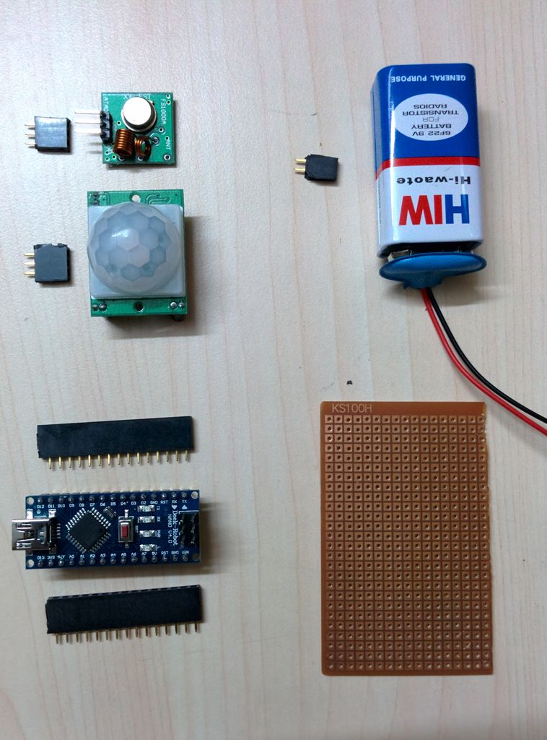
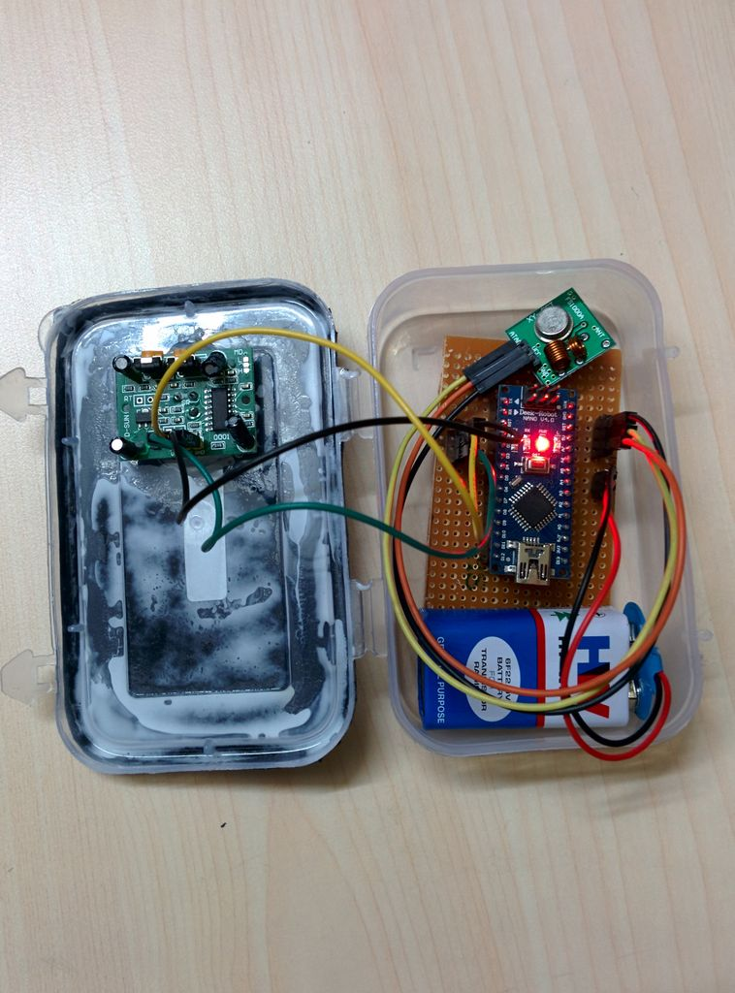

Slide 19
RECEIVER MODULE:
Bind the mini bread board and arduino uno by a rubber band
Place the RF receiver module on the bread board
Connect everything by jumper wires as per schematics
Prepare the Enclosure :
Mark a circle and rectangle on the front side of the enclosure.
Cut the marked portion.
Insert buzzer in the circular hole and switch in the rectangular hole.Then glue them.
Place every thing inside. Use scotch mounting pad to hold the battery and board firmly.
After making the both modules, place the transmitter module to the location where you want to protect. I kept it at our parking place. The receiver module should be placed inside your room.

Slide 20
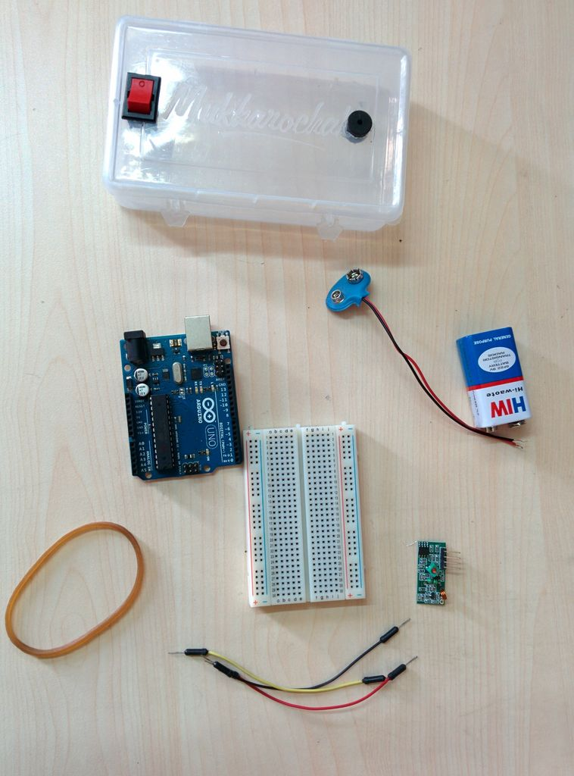
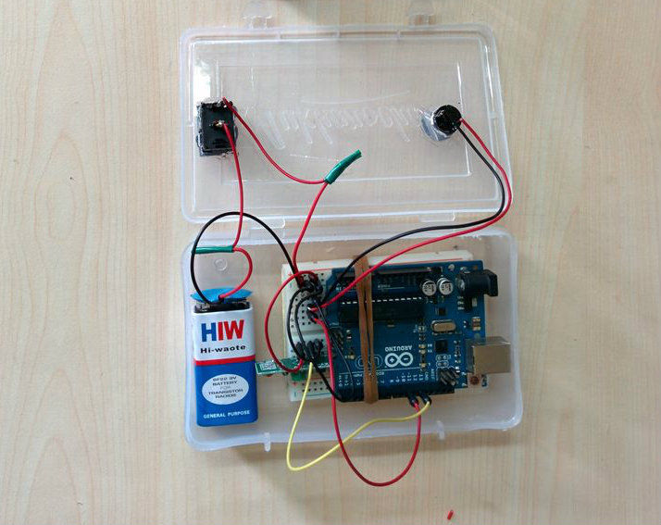

Slide 21
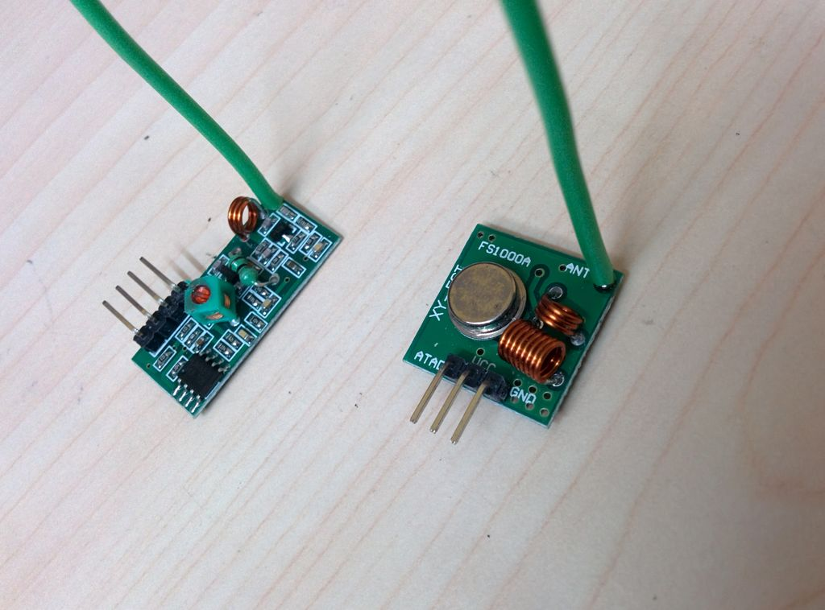
INCREASING THE RANGE:
The range without antennae is very limited. Putting an antenna on only the TX or RX will greatly extend your range, but putting one on each will extend it even farther. Most of the people think the tiny spiral copper wire on the module is an antenna but in reality it is an inductor.
If you look carefully in to the RF transmitter and receiver module there is no external antenna included. A small hole "ANT" is provided in the module to solder an external antenna.

Slide 22
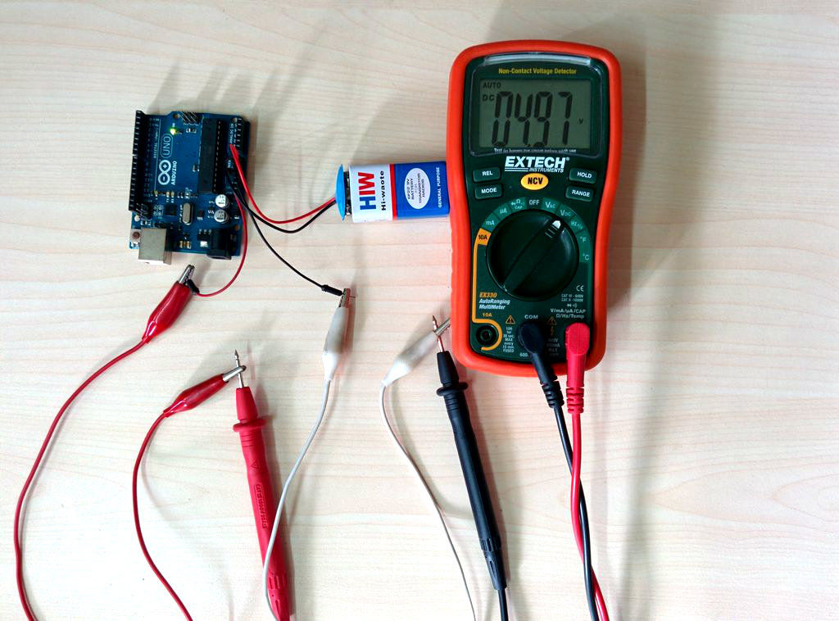
POWER SUPPLY:
During the uploading of code,the board is powered by USB cable. But when ever you want to use it in the real world,you need an external power supply.
Connect the positive terminal of a 9V battery to the Vin pin of the arduino and negative terminal of the battery to the GND pin of the arduino. After connecting the battery, measure the voltage across 5v and GND pin, it will approximately be 4.97v which is safe for our operation.

Slide 23
ADVANTAGES:
Reduced Crime (For keeping a home safe from burglars). Studies on crime prevention indicate that houses set up with motion detectors do help enhance security.
They are cost-effective, because the sensors are made of simple components that don’t cost much to make.
The sensor motion is very reliable because it uses body heat and wave lengths to calculate whether there is a movement or not, hence you can be certain that it won’t fail.
Portable, easy to install.
Easy to operate

Slide 24
DISADVANTAGES:
Taking time to adjust the sensitivity of the lighting when you first set it up helps mitigate this. Motion sensor alarms may also activate in response to pets if the sensors are not properly calibrated.
Same frequency interference, that’s the fatal weakness for wireless alarm system, the whole system will be disabled.
Backup battery problem.
Alarm Delay.

Slide 25
APPLICATIONS:
By making a few changes to this, we can use it for
Fire alarm systems
Water mist suppression in industries
Lighting control
Use a relay instead of buzzer which can be used to
1. DOOR OPEN / CLOSE
2. APPLIANCES ON/OFF
Use a camera to take pictures when there is a motion and send it to your email. This can be used to monitor your sleeping baby
You can send sms to your mobile when there is a motion.

Slide 26
REFERENCES:
Charleston Security Systems: Wired Security Systems vs. Wireless Security Systems (Pt. 2): The Wireless Solution
Safe Secure 24/7: Disadvantages of Wireless Security Alarms
Vstar: Disadvantages of Wireless Alarm System
http://www.electronicproducts.com/Analog_Mixed_Signal
http://en.wikipedia.org/wiki/Inductive_charging
http://electroncs.howstuffwoks.com/gadgets/wireless-mobile-charger.html
http://www.ecnmag.com/articles/wireless-power

Slide 27


